Slide 1


This presentation displays better in Slide Show mode…
Quantum Privacy Network and Proof of Trust BlockChain
enabling Personal Data Networks
Jonathan Hare
CEO, WebShield Inc.
jonathan@webshield.io
(415) 265-3250
(C) 2019, All Rights Reserved
www.webshield.io www.ep3foundation.org
Quantum Privacy Network and Proof of Trust BlockChain
enabling Personal Data Networks
Notes:
1

Slide 2

Quantum Privacy and Proof of Trust
is breakthrough innovation that uniquely empowers people with rights to their data,
and supports precision personalization on a global scale without undermining privacy
…establishing the foundation for a patient-centered value-driven marketplace for health…
FICAM-certified authentication and verification of identities & relationships of people, devices, records and organizations on a national scale
TNAP-accredited enforcement of diverse privacy, security & regulatory compliance requirements across organizations
Eliminates data blocking by enforcing the regulatory & contractual rights to data of individuals & organizations via existing systems & legal agreements
Convenient near-real time access to comprehensive longitudinal records from diverse enterprises and online users
Real-time online interaction and personalized decision support to patients, clinicians and caregivers
Frictionless population analytics & precision personalization for patient safety, clinical research, value-based reimbursement, whole-person care, etc.
(C) 2019, All Rights Reserved
2
Notes:
2

Slide 3

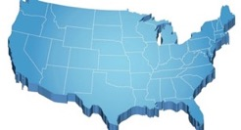


problem
data sharing, population analytics & online user interaction is essential…
VA Community Care
Opioid Safety
Value-Based Care
Medicare Access and CHIP Reauthorization Act
Alternative
Payment Models
OR
Merit-Based
Incentive
Payment System
but there is no way to reliably verify identities or relationships, link records or enforce privacy at Internet scale and traditional enterprise-centric computing has requirements that cannot possibly be satisfied across organizations at scale:
trustworthy
policy enforcement
& computation
assumes:
consistent identifiers, data models, roles & policies
mutually trusted proofing & authentication
mutually trusted encryption & key management
surveillance of users to detect comprised credentials & inappropriate behavior
which translates into…
pervasive identity, cybersecurity & privacy breaches; yet most data is unavailable…
(C) 2019, All Rights Reserved
3
Notes:
3

Slide 4

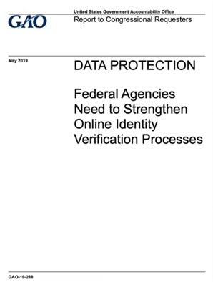
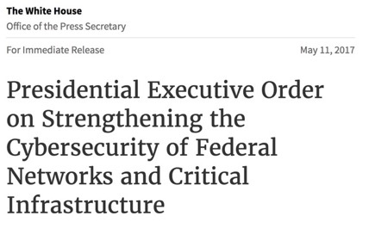
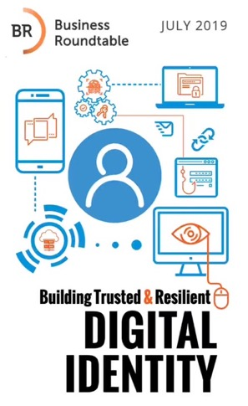
repeated failures have led to calls for more trustworthy
identity & cybersecurity and streamlined data sharing…
GAO is making recommendations to six agencies to strengthen online identify verification processes:
GAO recommends that CMS, SSA, USPS, and VA develop plans to strengthen their remote identity proofing processes by discontinuing knowledge-based verification.
GAO recommends that NIST supplement its technical guidance with implementation guidance to assist agencies in adopting more secure remote identity proofing processes.
HHS (on behalf of CMS), disagreed with GAO's recommendation because it did not believe that the available alternatives to knowledge-based verification were feasible for the individuals it serves.
Calls for “a single on-ramp for nationwide exchange for health information” and a solution to the patient identity challenge.
Business Roundtable Recommendations:
Action 1: Reduce Dependency on Passwords to Provide More Intuitive and Secure Authentication
Action 2: Eliminate Identity Proofing Solutions That Are Solely Knowledge Based
Action 3: Change the Use of Social Security Numbers
Action 4: Improve Government Support for Validating Identity Attributes and Verifying Identity Claims
Action 5: Reduce Barriers to the Adoption of New Technologies
Action 6: Establish a Public-Private Partnership to Focus on Implementation of Digital Identity Solutions at Scale
Action 7: Enhance Privacy Through Digital Identity
Action 8: Bolster Digital Identity Education and Awareness
(A) Agency heads shall show preference in their procurement for shared IT services…including email, cloud, and cybersecurity
(B) …shall coordinate a report to the President … regarding modernization of Federal IT. The report shall:
  (2) describe the legal, policy, and budgetary considerations relevant to … transitioning all agencies, or a subset of agencies, to: (aa) one or more consolidated network architectures; and (bb) shared IT services, including email, cloud, and cybersecurity services.
(C) The report … shall assess the effects of transitioning all agencies, or a subset of agencies, to shared IT services with respect to cybersecurity...

Slide 5


Quantum Privacy Network and Proof of Trust BlockChain
lets people & organizations that don’t trust each other share, analyze & re-use sensitive resources on a global scale, with bulletproof privacy, cybersecurity & regulatory protection
Quantum
Privacy
Network
Privacy
Agent
Internet software that allows anything to be safely published as protected, re-usable resources
supports any computation without any revealing information to any person or organization
enables precision privacy and cybersecurity that is orders of magnitude harder to breach
Trust Model
Service
Proof of Trust
BlockChain
Proof of Trust
BlockChain
binds trust criteria & provenance to resources, which are automatically inherited by any derivatives
simultaneously enforces diverse and changing legal, regulatory and commercial terms through time
supports global pooling, re-use & re-computation of diverse resources with disparate policies
Trust
Block
Privacy Network Exchange
Trust
Criteria
Resource
Description
Trust
Credentials
Authorization Network
global trusted identities, attributes & relationships for people, devices, data, organizations, etc.
accredited compliance with diverse privacy, security & regulatory requirements (HIPAA, GDPR, etc.)
enforces rights of individuals and organizations to access and authorize use of their data
Authorization
Network
Authorization
Domain
Personal Data Network
Personal
Data
Network
creates comprehensive person-centered longitudinal profiles with verified provenance
aggregates data via existing networks, systems & agreements, and from real-time user interaction
supports privacy-preserving precision personalization and global population analytics
(C) 2018, All Rights Reserved
enforce rights of individuals and organizations to access and authorize user of data
on a nationwide scale via existing infrastructure and agreements.
Notes:
5

Slide 6
Freely Licensed to support:
Enforcing privacy, cybersecurity and regulatory compliance;
Enforcing regulatory and contractual rights to data;
Enforcing personal policies of individuals
Publishing and managing resources within Enterprise Domains.
Revenue Share from Privacy Network Exchange:
Resources Providers get 70% of net value derived from resources they publish and any derivatives
Privacy Network Exchange gets remaining 30% of value, which is allocated among exchange providers
Value is distributed as fiat currency, in-kind resources, or value tokens, and is allocated among Resource Providers and Value Networks based on agreed upon terms specified in Trust Criteria
The Privacy Network Exchange creates a global exchange and marketplace for
sensitive, regulated and proprietary resources that are currently most unavailable, allowing them to be combined and transformed into precision personalized services via Value Networks.
The Authorization Network can automatically discover records about a person across the ecosystem, generate authorization credentials that assert the combined regulatory & contractual rights of that person & participating enterprises and government agencies, and virtually aggregate records into each person’s Personal Data Network.
Supports and Enhances existing revenue models
Self-funding network, freely available to individuals and organizations
Self funding
Tracks
Free
The Privacy Network Exchange creates a Global Exchange and Marketplace for Value
Value Networks combine, transform and reprocess resources and user interaction into precision personalized services
Patient Safety Network
Clinical Research Network
tracks rights from re-use, re-processing and re-combination of resources via Value Tokens, allowing the network to be freely available to all participants, while offering revenue to resource providers.
70% of Value derived from their resource contributions to Value Networks, paid as in-kind resources, money, or value tokens
Exchange Providers split the remaining:
30% of Value from Value Networks
Personal Health Network
The Authorization Network offers
Free privacy, cybersecurity protection & regulatory compliance
Free enforcement of legal, regulatory & contractual rights to access data
Free enforcement of personal policies for individuals
Free in-kind resource exchange
Personal Education Network
Personal E-Commerce
Privacy Network Exchange
EP3 Foundation
Any person or organization can safely publish their most sensitive, regulated & proprietary assets to the Privacy Network Exchange as protected Internet resources, allowing them to be safely shared, combined or re-used by simply “linking” them to any other resources.
Authorization Network
EP3 Foundation
Quantum
Privacy Network
Personal Data Network
Proof of Trust
BlockChain
money
trust models
people
organizations
data
contracts
devices
infrastructure
software
(C) 2019, All Rights Reserved
Immediately
free marketing & sales referrals, ecosystem pull
incremental revenue via vendor’s existing licensing and distribution models
Upon PN-Enablement and TNAP Accreditation
streamlines privacy & regulatory compliance, customer adoption and access to data & users
additional high-margin, low-friction transactional network revenue model
opens up previously inaccessible market and product opportunities

Slide 7







































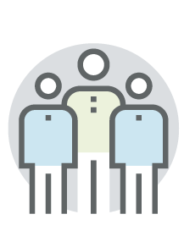







TNAP
Trusted Network Accreditation Program
Partial list of participants in TNAP Steering Committee & Work Groups organizing meetings…
and 100+ EHNAC accredited organizations, including…
Quantum
Privacy Network
and 70+ SAFE BioPharma members & partners, including…
21st Century Cures Act calls for a “single on-ramp to nationwide exchange of health information”, and directs HHS/ONC to seek a solution to the patient identity problem.
TNAP was founded by EHNAC, EP3 Foundation, WEDI, SAFE BioPharma and e-HI to develop an accreditation framework capable of realizing the goals of the 21st Century Cures Act.
WebShield and the EP3 Foundation have organized a Beta Network for the TNAP Accreditation Program which will prove the technical, legal and regulatory viability of the Quantum Privacy Network and Proof of Trust BlockChain, and demonstrate its’ use in a representative range of applications.
Steering
Committee
Work
Groups
TNAP Founding Members
and 380+ WEDI and 70+ eHealth Initiative members, 100+ EP3 Foundation Fellows & Trustees
(C) 2019, All Rights Reserved

Slide 8



















EP3 - TNAP Accreditation Beta Network
Certara / Synchrogenix
pharmacovigilance
clinical trial simulation
regulatory writing
safety analytics & reporting
60+ Health Regulatory Agencies
1,400 commercial entities
400 academic medical centers
FDA, CDC (Open MDI)
SAFE App
patient safety services
e-prescribing & virtual pharmacy
nationwide labs network
in-home testing
SAFE Health
Certara / Synchrogenix
Consumer-Directed Health
Patient Safety Analytics
PRA Health Sciences
CRO in 60 countries
15,000 employees
most major pharma
3,500+ clinical studies
IBM ConnectWell San Diego
regional network
global integrator & platform
blockchain trust anchor
Quantum
Privacy Network
EP3 Foundation
ConnectWell San Diego
Authorization Network
PRA Health Sciences
Government Agencies
EP3 Foundation
Clinical Research Organization
Personal Data Network
EP3 & TNAP Accredited Trust Credentials supporting:
authentication, proofing, attribute verification
subject access (e.g. HIPAA Individual Right of Access)
public health & patient safety
age verification & parent-child verification
consumer controlled records (FTC FIPPS)
cross-organizational consent & population analytics
Personal Education
Schools & Ed Institutions
Distributed Health Platform
IT Services & Integrators
Education & Child Services
nationwide network of student information systems
Perspecta
$5 billion IT integrator - most federal agencies & 100s of state and local entities are clients
distributed health platform
8
(C) 2019, All Rights Reserved

Slide 9
Quantum Privacy Network
However, anyone sharing resources with an enterprise network must trust that enterprise, its’ privacy & security practices, and any users or systems it authorizes access to. Further, any data sent to or stored within an enterprise network is subject to that enterprise’s legal, regulatory & contractual obligations.
SAFE Health
Certara / Synchrogenix
Consumer-Directed Health
Patient Safety Analytics
Quantum
Privacy Network
Enterprise Privacy Networks can be hosted in an organization’s existing environments (e.g. in AWS, Azure, docker containers, VMware, etc.) and protected by their own encryption & security infrastructure.
The perimeter of the enterprise network is defined by it’s Trust Credentials, and can span different platforms, systems & geographies.
EP3 Foundation
ConnectWell San Diego
Authorization Network
PRA Health Sciences
Government Agencies
EP3 Foundation
Clinical Research Organization
Personal Data Network
Each enterprise directly controls Trust Criteria that determines which users and systems are allowed to access the data, computational output or application functionality hosted within their enterprise network.
Enterprises can also issue or earn Trust Credentials that describe the characteristics, provenance and the basis for trusting the people, systems, data, and computational output within their enterprise network.
Personal Education
Schools & Ed Institutions
Distributed Health Platform
IT Services & Integrators
9
(C) 2019, All Rights Reserved

Slide 10
Value Networks
Value Networks allow people and organizations to pool, re-use & re-process their most sensitive, proprietary, and regulated resources, and share the value derived either as in-kind resources, via payments of fiat currency, or by earning “network equity” via Value Tokens.
Authorization Domain
Authorization Domain
Value Networks are partitioned across privacy domains hosted within secure enclaves on trusted computing platforms, and are protected within a Software Defined Perimeter.
Enterprises may choose to host Value Domains in their own environments, encrypting any data they share using encryption keys they trust.
SAFE Health
Certara / Synchrogenix
Authorization
Domain
Authorization
Domain
Consumer-Directed Health
Patient Safety Analytics
Organizations hosting privacy domains of Value Networks have no access to data or computation performed within, and no meaningful information is revealed to anyone.
Authorization Domain
Quantum
Privacy Network
distributed cryptographic
infrastructure
Authorization Domain
EP3 Foundation
encrypted
crypto-hashed
tokenized
partitioned
Authorization
Domain
Authorization Network
Authorization
Domain
ConnectWell San Diego
EP3 Foundation
PRA Health Sciences
Government Agencies
Personal Data Network
Clinical Research Organization
There is no need for consent or legal agreements for population analytics, because no information is ever revealed to any person or organization, nor does it leave the control of its original source.
Patient Safety Network
Authorization Domain
Clinical Research Network
Authorization Domain
Authorization
Domain
Personal Health Network
Personal Education
Authorization
Domain
Schools & Ed Institutions
Distributed Health Platform
Whole Person Care Network
IT Services & Integrators
Anything published to Value Networks is encrypted, crypto-hashed, tokenized, randomized and/or partitioned via Privacy Pipes across a distributed network of cryptographic infrastructure. While the resulting output is completely opaque (“flat data”) to anyone who gains access to it, it still supports any computation
– but only by authorized software running within secure enclaves within that Value Network.
Personal Education Network
10
(C) 2019, All Rights Reserved

Slide 11
Proof of Trust
The Unified Trust Model and Proof of Trust BlockChain enables distributed governance of every aspect of trust (identity, commercial terms, compliance, semantic interoperability, etc.) without assuming consistency or mutual trust across stakeholders. It enables:
certified compliance with diverse laws & regulations (GDRP, CCPA, HIPAA, COPPA, etc.)
simultaneous enforcement of policies of multiple stakeholders
interoperability and resource pooling across disparate technologies and trust models
Authorization Domain
Authorization Domain
SAFE Health
Certara / Synchrogenix
Authorization
Domain
Authorization
Domain
Consumer-Directed Health
Patient Safety Analytics
Privacy Agents cryptographically bind Resource Descriptions to their Trust Criteria and Trust Credentials to create Trust Blocks, which are written to the Proof of Trust BlockChain to enable shared governance.
Proof of Trust
BlockChain
Authorization Domain
Quantum
Privacy Network
Authorization Domain
EP3 Foundation
Trust
Block
Authorization
Domain
Authorization Network
Authorization
Domain
ConnectWell San Diego
EP3 Foundation
PRA Health Sciences
Government Agencies
Privacy
Agent
Clinical Research Organization
Personal Data Network
Patient Safety Network
trust
criteria
resource
description
trust
credentials
Authorization Domain
Clinical Research Network
Authorization Domain
Trust Model
Service
Trust Model
Service
Authorization
Domain
Personal Health Network
Personal Education
Authorization
Domain
authorized purpose & recipients
regulatory requirements
cybersecurity requirements
payment & licensing terms
semantic interoperability, etc.
Distributed Health Platform
Schools & Ed Institutions
Whole Person Care Network
APIs, interfaces or semantics
data model & terminologies
provenance & audit history
certifications & assessments
supporting documentation
right to use data, file or document
right to use software, algorithm
right to rely upon legal contract
right to display a brand
IT Services & Integrators
Personal Education Network
11
(C) 2019, All Rights Reserved

Slide 12





Proof of Trust
Once Proof of Trust has been verified, the Privacy Agent opens a Privacy Pipe (via a HTTP Proxy accessible as a URL or Smart Contract) to make the Resource available to Recipient Domain.
Before authorizing a request for a resource, the Privacy Agent checks the Proof of Trust BlockChain to confirm the resource’s Trust Criteria are satisfied by the recipient’s
Trust Credentials.
Authorization Domain
Authorization Domain
‘Quantum’ Privacy Domains keep data fully opaque and partitioned at all times, enabling virtually unbreakable security up to millions of times more difficult to breach than traditional approaches, yet with modest computational overhead.
lab
record
SAFE Health
Trust
Block
Authorization
Domain
Certara / Synchrogenix
Authorization
Domain
Consumer-Directed Health
Patient Safety Analytics
TNAP¹ Accredited
CEAP² Accredited
Privacy
Pipe
FICAM Certified
SAFE Certified
Authorization Domain
Quantum
Privacy Network
CFR 42-2 Compliant
HIPAA Compliant
Authorization Domain
EP3 Foundation
NIST 800-53
Certified
Trust
Block
lab
record
Authorization
Domain
Authorization Network
Authorization
Domain
ConnectWell San Diego
EP3 Foundation
PRA Health Sciences
Government Agencies
Clinical Research Organization
Personal Data Network
Trust Criteria and Trust Credentials are automatically inherited by any derivatives (aggregates, analytic outputs or user responses) no matter where resources are utilized, how they are transformed, or what derivatives emerge – so policies are consistently enforced across the network and through time.
‘Classical’ Privacy Domains map data into formats and terminologies specified by recipient software’s trust credentials while it is still opaque, and partitions computation across secure enclaves.
This supports off-the-shelf cloud-enabled software, yet enables bullet-proof security up to thousands of times more difficult to breach.
Patient Safety Network
Authorization Domain
Clinical Research Network
Authorization Domain
Authorization
Domain
Personal Health Network
Personal Education
Authorization
Domain
Schools & Ed Institutions
Distributed Health Platform
Whole Person Care Network
IT Services & Integrators
Personal Education Network
12
(C) 2019, All Rights Reserved

Slide 13




























Authorization Network
Quantum Privacy & Proof of Trust enables organizations and individuals to pool their data & infrastructure to create a person-centered Authorization Network that authenticates & verifies the identities of people; links them to their devices, records and accounts; and verifies their relationships with other people and organizations – all to an unprecedented level of assurance.
Authorization Domain
Authorization Domain
B
Biometric Match
w/ Government ID
SAFE Health
Certara / Synchrogenix
Assurance Levels
C
HIE Network
Authorization
Domain
Authorization
Domain
Consumer-Directed Health
The Authorization Network evaluates all of the information and trust credentials available from the network to generate credentials describing the identity, relationships & characteristics of people, devices, systems, organizations or data.
Network credentials are rated based on a variety of different schemes – enabling a vastly higher level of assurance and much more precise and useful claims.
Patient Safety Analytics
NIST
Rating
AuthNet
Rating
Trust
Rank
C
Commercial Labs
Individual services for authentication, identity and attribute verification, entity resolution, key management, encryption, etc. can earn trust credentials and be individually rated by various trust authorities for provenance and trustworthiness, whether they are hosted within Enterprise Networks or within shared Authorization Domains.
Level 4
A
Platinum
In Person
Proofing
Quantum
Privacy Network
Level 3
B
Gold
Authorization Domain
Authorization Domain
B
Level 2
C
Silver
DMV
Records
EP3 Foundation
person-
centric
graph
Consent & Authorization
Cybersecurity Surveillance
Encryption & Tokenization
Directory & Discovery
Key Management
Level 1
D
Bronze
Authorization
Domain
Authorization Network
Authorization
Domain
ConnectWell San Diego
PRA Health Sciences
C
Government Agencies
Clinical Research Organization
County
Records
C
Authorization Domain
Authentication
Identity & Attribute Validation
certified
800-53-3
Authorization Domain
Email
Facial
Touch ID
Voice
ID Verification
School
Information
Systems
Authorization
Domain
Personal Education
Authorization
Domain
Schools & Ed Institutions
SMS
Password
Device ID
Authenticator
Distributed Health Platform
C
IT Services & Integrators
The Authorization Network virtually connects the authentication and authorization systems and identity verification sources of participating organizations and neutral service providers to form a global network. Users are verified and authorized based on the collective knowledge and capabilities of all participants, with many-factor authentication, proofing, record matching and cybersecurity surveillance.
13
(C) 2019, All Rights Reserved

Slide 14



Authorization Network
Authorization Credential
  Requestor SubjectID verified
  Requestor API Verified
  Requestor Authorized to make request via API
  Source(s) Authorized/Required to fulfill Request
  Cybersecurity Surveillance Performed
  Requestor SubjectID Matches Source SubjectIDs
  Recipient SubjectID(s) Matches Requestor SubjectID
  User Authenticated
  User Identity Proofed
> verified to required assurance level for recipient & use
Gold
TNAP Accredited
EP3 Certified
FISMA Certified
FISMA certification of the Authorization Network will effectively indemnify parties that rely upon Authorization Credentials by documenting an enforceable legal obligation for record sources to comply with record requests.
Every aspect of enforcement
and governance is within the “system boundaries” of the
NIST 800-63-3 certification.
The only meaningful information that flows out of the Authorization Network are privacy-preserving encrypted Authorization Credentials.
These incorporate attestations verified by neutral trust authorities of every claim necessary to allow an organization to access data via their existing systems & networks based on their existing contractual, legal & regulatory rights, or rights delegated by other parties.
Authorization Domain
Authorization Domain
SAFE Health
Certara / Synchrogenix
Authorization
Domain
Authorization
Domain
B
Consumer-Directed Health
Patient Safety Analytics
B
B
B
Authorization Domain
Quantum
Privacy Network
800-53-3
Authorization Credentials unambiguously document the legal, regulatory and/or contractual basis for authorizing each request, verifying each of the underlying assumptions to the required assurance level, as specified by neutral trust authorities.
Authorization Domain
certified
EP3 Foundation
person-
centric
graph
Consent & Authorization
Cybersecurity Surveillance
Encryption & Tokenization
Directory & Discovery
Key Management
Authorization
Domain
Authorization Network
Authorization
Domain
ConnectWell San Diego
PRA Health Sciences
Government Agencies
Clinical Research Organization
Authorization Domain
Authentication
Identity & Attribute Validation
Authorization Domain
Key: <UTM entity>
[optional clause]
verified to required assurance level
accredited by trust authority
derived from other claims
HIPAA Individual Right of Access
<online user> is <person>
<person> is subject of <records>
<records> are <healthcare records> held by <HIPAA Covered Entity>
(<person> or <guardian>) directs <records> be delivered to <consumer_controlled_service>
therefore…
<records> must be delivered to <consumer_controlled_service> pursuant to <Individual_Right_of_Access>
Email
Facial
Touch ID
Voice
ID Verification
Authorization
Domain
Personal Education
Authorization
Domain
Schools & Ed Institutions
SMS
Password
Device ID
Authenticator
Distributed Health Platform
IT Services & Integrators
14
(C) 2019, All Rights Reserved

Slide 15

















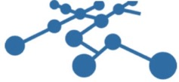


















Personal Data Network
The Authorization Network can discover records about a person across the entire ecosystem; generate authorization credentials that assert the combined regulatory & contractual rights of the individual & any participating enterprises; request records via existing systems and legal agreements; and virtually aggregate them into that individual’s Personal Data Network.
Authorization Domain
Authorization Domain
Protected Data Domain
Personal Data Domain
Authorization
Domain
SAFE Health
Certara / Synchrogenix
The Personal Data Network can be federated across privacy domains in secure enclaves hosted by disparate enterprises and vendors, aggregating in-kind contributions of data, hosting, software licenses and admin services.
Authorization
Domain
Consumer-Directed Health
Patient Safety Analytics
Protected Data
Domain
Protected Data
Domain
The unique ability to pool resources in a person-centered network with access controlled by the subject translates into:
the most complete and comprehensive data
the highest quality & best documented provenance
the lowest marginal costs & the best performance
the least regulatory & contractual constraints on data use
real-time interaction with the person & their network
Authorization Domain
Quantum
Privacy Network
Authorization Domain
Personal Data Domain
Personal Data Domain
EP3 Foundation
*customers of launch partners, for illustration only
Authorization
Domain
Authorization Network
Authorization
Domain
ConnectWell San Diego
EP3 Foundation
PRA Health Sciences
Government Agencies
Clinical Research Organization
Authorization
Domain
Personal Data Network
Protected Data
Domain
Once source records are available within the personal data network, they can be linked together and reconciled into comprehensive longitudinal records, cleansed, validated and normalized into various formats and terminologies, and replicated and edge-cached for backup, performance and availability.
Authorization Domain
Any enterprise can leverage their IT systems, contracts & license rights as a conduit to pull data from existing networks and systems and route it to the record subject’s personal data network, earning value tokens a Trust Service Provider.
The original sources of data need not know that the Privacy Network was involved, as data will flow based on existing contracts and systems.
Personal Data Domain
Authorization Domain
Data Adapters
Format Transformation
Terminology Mapping
Linking & Reconciliation
Personal Data Domain
Authorization
Domain
Personal Education
Authorization
Domain
Schools & Ed Institutions
Distributed Health Platform
Protected Data
Domain
IT Services & Integrators
Protected Data
Domain
Radiology & Imaging
Government
Records
Demographics
Online
Profiles
EMR &
Clinical
Claims/
Admin
15
(C) 2019, All Rights Reserved
HR/Payroll
Device
Genomic
Pharmacy
Labs

Slide 16













Personal Privacy Network
Authorization Domain
Authorization Domain
Personal Data Domain
Personal Data Domain
SAFE Health
Digital Content
Authorization
Domain
Certara / Synchrogenix
Apps & Websites
Spouse
Clinician
Authorization
Domain
Consumer-Directed Health
Child
Friend
Patient Safety Analytics
Protected Data
Domain
Colleague
Protected Data
Domain
Teacher
Relationships
Personal information remains encrypted until recipients are authenticated and authorized, and isn’t revealed to apps, messaging clients or websites used for sharing.
Supports precision privacy down to individual attributes, a specific person, on a single device – decrypted only on user’s device.
Policies are linked or automatically bound to files, data and messages, and enforced end-to-end.
Authorization Domain
Quantum
Privacy Network
Authorization Domain
Personal Data Domain
EP3 Foundation
Personal Data Domain
Authorization
Domain
Authorization Network
Authorization
Domain
ConnectWell San Diego
EP3 Foundation
PRA Health Sciences
Government Agencies
Clinical Research Organization
Authorization
Domain
Personal Data Network
Protected Data
Domain
Authorization Domain
Personal Data Domain
Authorization Domain
Personal Privacy Networks gives each individual:
end-to-end personal control over digital content and records.
trustworthy verification of identities, attributes & relationships
privacy-protected messaging and sharing with family, friends, colleagues, acquaintances and organizations.
precision personalization based on their most sensitive, regulated data without revealing data or undermining privacy.
Personal Data Domain
Authorization
Domain
Personal Education
Authorization
Domain
Schools & Ed Institutions
Distributed Health Platform
Protected Data
Domain
IT Services & Integrators
Protected Data
Domain
Radiology & Imaging
Government
Records
Demographics
Online
Profiles
EMR &
Clinical
Claims/
Admin
16
(C) 2019, All Rights Reserved
HR/Payroll
Device
Genomic
Pharmacy
Labs

Slide 17


Patient Safety Network
45 CFR § 164.512 - Uses and disclosures for which an authorization or opportunity to agree or object is not required.
(b)Standard: Uses and disclosures for public health activities -
(1)Permitted uses and disclosures. A covered entity may use or disclose protected health information for the public health activities and purposes described in this paragraph to:
(iii) A person subject to the jurisdiction of the Food and Drug Administration (FDA) with respect to an FDA-regulated product or activity for which that person has responsibility, for the purpose of activities related to the quality, safety or effectiveness of such FDA-regulated product or activity. Such purposes include:
(A) To collect or report adverse events (or similar activities with respect to food or dietary supplements), product defects or problems (including problems with the use or labeling of a product), or biological product deviations;
(B) To track FDA-regulated products;
(C) To enable product recalls, repairs, or replacement, or lookback (including locating and notifying individuals who have received products that have been recalled, withdrawn, or are the subject of lookback); or
(D) To conduct post marketing surveillance;
regulatory submissions
public health reporting
opioid safety & behavioral health
suicide prevention
mental health
serious adverse event reporting
post-market & biosurveillance
Pharmacovigilance
track & trace serialization
food supply-chain safety
The regulatory rights of the FDA alone are sufficient to create a nationwide Network:
Authorization Domain
Authorization Domain
Patient Safety Domain
Protected Data Domain
Personal Data Domain
SAFE Health
Certara / Synchrogenix
Authorization
Domain
Authorization
Domain
Clinical Research
Domain
Consumer-Directed Health
Patient Safety Analytics
Protected Data
Domain
Protected Data
Domain
Authorization Domain
Quantum
Privacy Network
Authorization Domain
Patient Safety Domain
Personal Data Domain
EP3 Foundation
Personal Data Domain
EP3 Foundation
Authorization Network
Authorization
Domain
Authorization Network
Authorization
Domain
ConnectWell San Diego
EP3 Foundation
PRA Health Sciences
Government Agencies
Clinical Research
Domain
Clinical Research Organization
Authorization
Domain
Regulators
Patients
Clinicians
Protected Data
Domain
Personal Data Network
Patient Safety Network
Authorization Domain
Personal Data Domain
Authorization Domain
Patient Safety Domain
Personal Data Domain
Authorization
Domain
Personal Education
Enforcing the legal, regulatory and contractual rights of patients, clinicians, providers, payers, pharma and device manufacturers and regulatory agencies can create a global privacy-preserving Patient Safety Network offering unprecedented capabilities:
  Comprehensive data in near real-time, including behavioral & mental health.
  Real-time interaction, messaging & personalized safety decision support at point of care.
  Real-time public health analytics with targeted outreach to at-risk patients.
Authorization
Domain
Schools & Ed Institutions
Distributed Health Platform
Protected Data
Domain
Clinical Research
Domain
IT Services & Integrators
Protected Data
Domain
Radiology & Imaging
Government
Records
Demographics
Online
Profiles
EMR &
Clinical
Claims/
Admin
17
(C) 2019, All Rights Reserved
HR/Payroll
Device
Genomic
Pharmacy
Labs

Slide 18
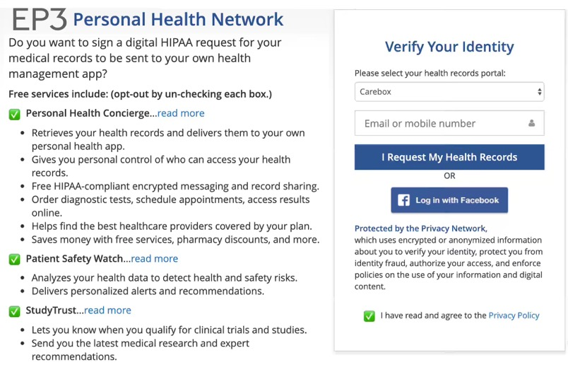
Patient-Centered Value Networks
Once data is in the Privacy Network from any source for any purpose, record subjects can easily invoke their individual rights to authorize use of their data by other value networks, unlocking value.
Privacy & security risks are negligible because value networks:
perform computation without revealing data to any person or organization, and data remains under the control of their sources;
have security & privacy that is vastly better than the data’s existing sources, and are accredited & certified by trustworthy authorities;
any user interaction is privacy-preserving and under the control of the record subject via the authorization network.
Thus, high-level opt-ins are sufficient to authorize wide-ranging use by value networks, without requiring users review and understand mind-numbing security and privacy disclosures in detail.
SAFE Health
Certara / Synchrogenix
Consumer-Directed Health
Patient Safety Analytics
Quantum
Privacy Network
EP3 Foundation
ConnectWell San Diego
Authorization Network
PRA Health Sciences
Government Agencies
EP3 Foundation
Clinical Research Organization
Personal Data Network
Patient Safety Network
Clinical Research Networks supports continuous real-time analysis of comprehensive longitudinal patient records to detect promising therapies, and enables direct-to-patient end-to-end automation of recruiting, enrolling and retaining patients in clinical trials.
Clinical Research Network
Personal Education
Personal Health Network
Personal Health Networks dramatically improve the cost and quality of care by enabling patient-centered, consumer directed health, personalized population health, pay-for-value reimbursement, and real-time prior authorization on a nationwide scale.
Schools & Ed Institutions
Distributed Health Platform
IT Services & Integrators
18
(C) 2019, All Rights Reserved

Slide 19
Whole Person Care
Whole Person Care
The Privacy Network can simultaneously satisfy disparate and conflicting federal and state privacy laws so that all of the data sources and people needed to support efficient whole-person care can be connected without risking privacy or compliance.
Clinical Research
Domain
Insurers
Patient Safety Analytics
Law Enforcement
Personal information isn’t revealed to organizations, but only to the specific people who need it to deliver care or services, with robust cybersecurity and privacy & access control policies specified by the subject themselves.
Spouse
Parent
Clinician
Caregiver
Child
Friend
Teacher
Quantum
Privacy Network
Courts
Healthcare Providers
EP3 Foundation
Authorization Network
EP3 Foundation
Whole Person Care
Personal Data Network
Comprehensive longitudinal records can be analyzed in secure domains of the whole person care network to enable privacy-preserving personalized decision support, coordination of services
& targeted outreach.
Patient Safety Network
Clinical Research
Domain
Child Welfare Services
Public Health Agencies
Clinical Research Network
Personal Health Network
Whole Person Care
Whole Person Care Network
Schools & Ed Institutions
Clinical Research
Domain
Social Service Providers
19
(C) 2019, All Rights Reserved

Slide 20

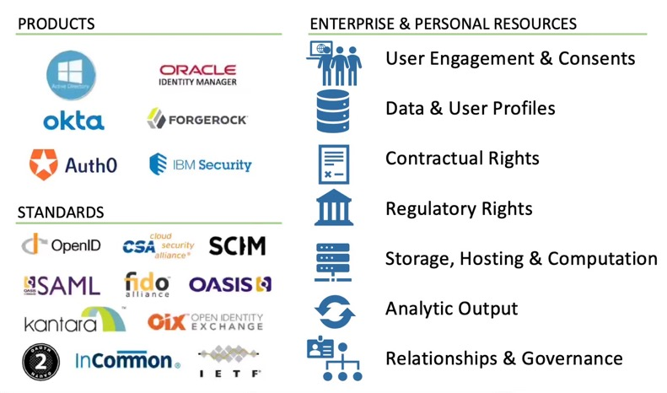
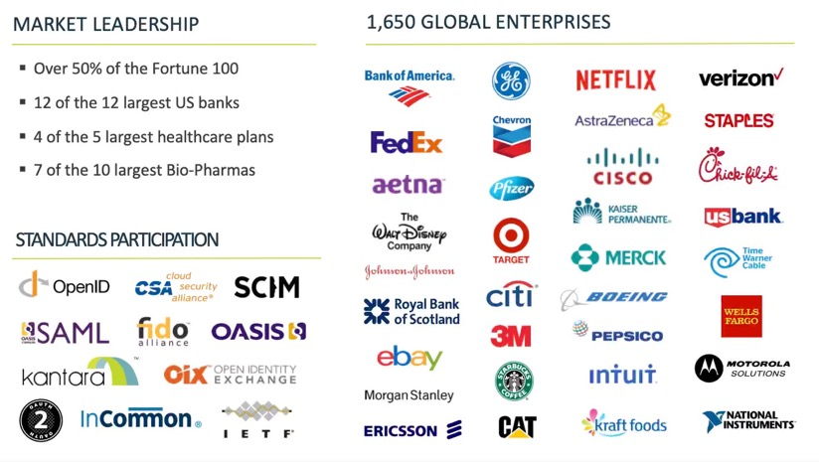
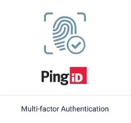
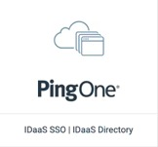
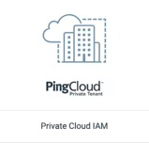
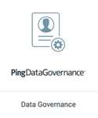
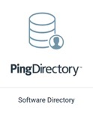
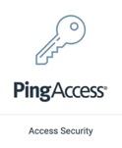
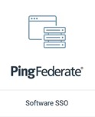
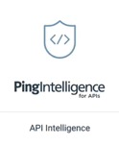








Value Networks
Vendors can convert their installed bases into Value Networks by bundling accredited Privacy Adapters with their products, allowing customers to safely pool sensitive, proprietary and regulated resources (data, analytic outputs, user interaction, etc.) to enable diverse value-added services on a global scale.
Sponsors can grow their Value Networks by distributing Privacy Adapters that pull in resources via any vendor’s products or technologies, as well as resources controlled by their customers and users.
Value Networks can pool resources from existing deployments within the enterprise domains of their customers, or from shared services deployed within the Value Network.
Authorization Network
Authorization Domain
Ping Identity Network
Authorization
Domain
Authorization Network
Authorization
Domain
EP3 Foundation
Value Networks can exchange, pool, or sell rights to use resources to other Value Networks or end-customers either directly, or via the PNX.
The resulting revenue, in-kind resources and Value Tokens are allocated among the Value Network sponsors and resource publishers based on the agreed-upon terms.
Personal Data Network
Precision FDA
Authorization Network
Patient Safety Network
PRA Health Sciences
Authorization Network
Clinical Research Network
Global No-Password Single-Sign-On
Many-Factor Authentication & Identity Proofing
Verified/Certified Identities & Attributes
Global User Consent & Data Governance
User Interaction & Comprehensive User Profiles
Authorization
Domain
Authorization
Domain
20
(C) 2019, All Rights Reserved

